Slide 1
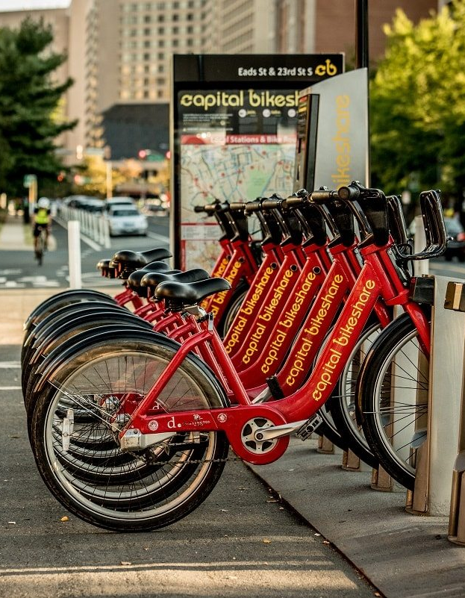
CAPITAL BIKESHARE Data Analysis
Vasu Devan
Notes:
Good After noon Everyone
Im VasuDevan today we are going to Bulid a model to Predict whether the Customer will default on his loan or not

Slide 2
EDA on DATA
MODELS COMPARISION
Solution Process
Problem Overview
Pre-processing Data
Recommendation
Overview of the Presentation

Slide 3
Problem Overview
What is the Business problem?
Will the Customer Be Member or Casual
Using insights in the business domain.

Slide 4
Objective
Preforming EDA
Identifying the Key Variables influencing the Problem
Selecting the best Fit Model
Suggesting the Client who may Member or Casual

Slide 5




Solution Process
Model Validation
Model Performance measure on
Testing data set using Few Matries
The Data set from capital bikeshare consist the Details of Customers of Capital bike share,
By Following the Steps we would provide the Company if the Customer would Member or Casual
STEP
04
Model Preparation
We teach the model
Using Training dataset
STEP
03
Analytical approach
Scaling the Data, Selecting Models: Logistic Regression, Random Forest, Gradient Boosting
STEP
02
Analyse Data
Exploratory Data Analysis, Label & One-Hot Encoding, Missing Values Treatment
STEP
01

Slide 6
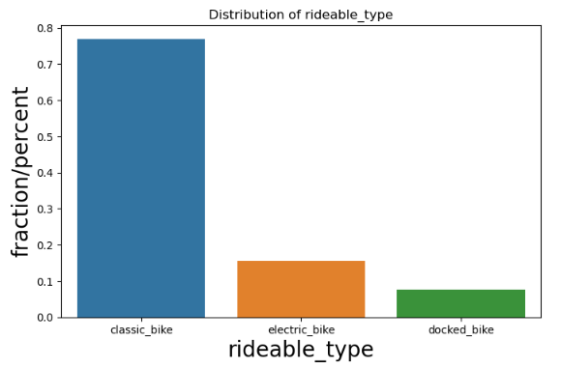
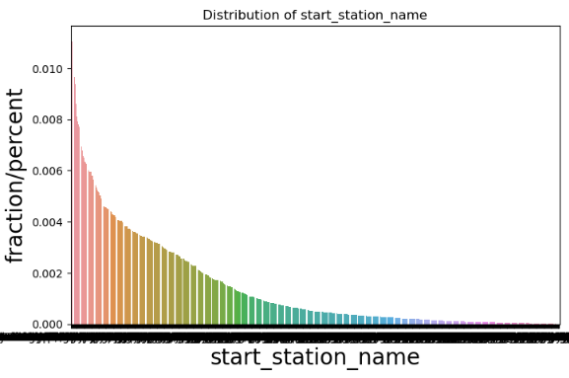
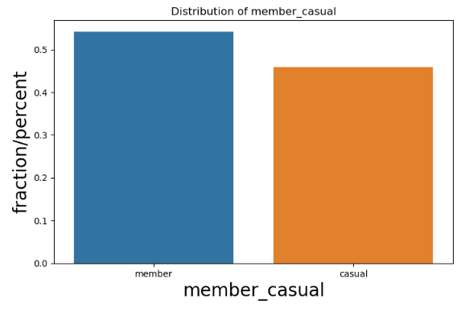
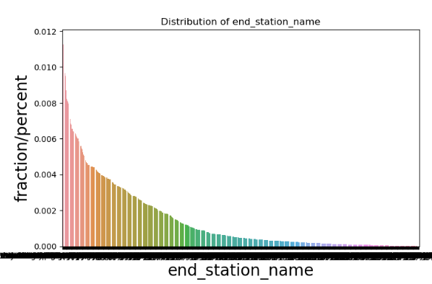
EDA
Univariate Analysis - Categorical

Slide 7
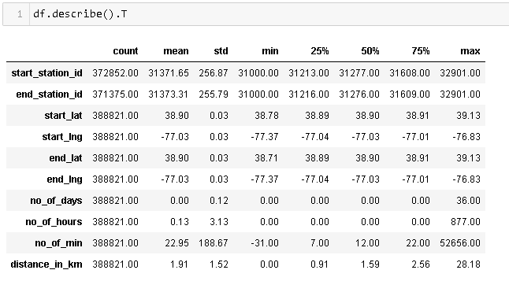
Univariate Analysis - Numerical

Slide 8
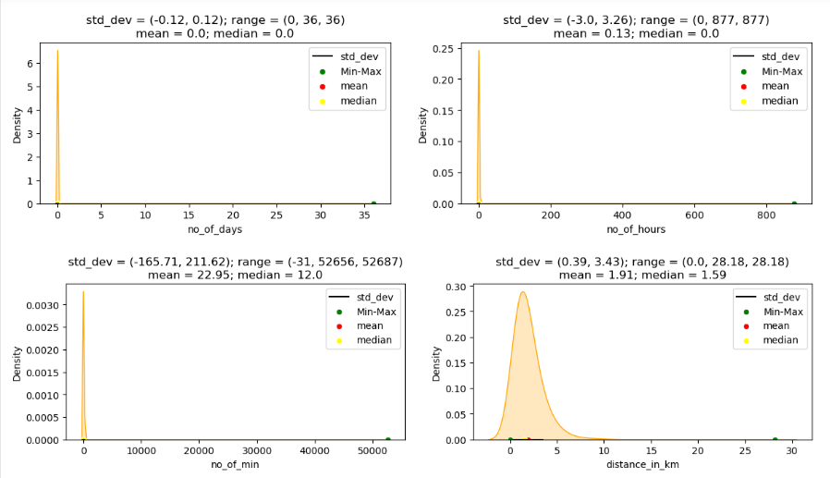

Slide 9
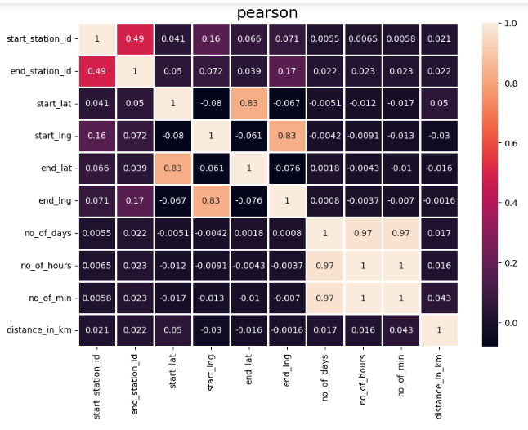
Bivariate Analysis : Numerical-Numerical

Slide 10
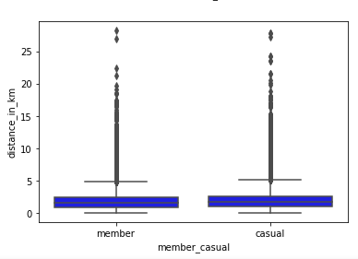
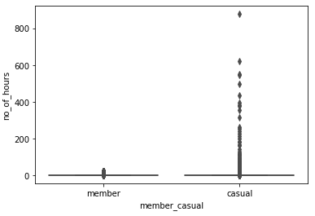
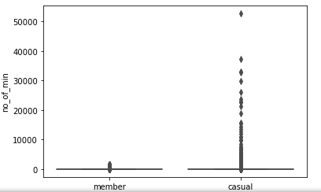
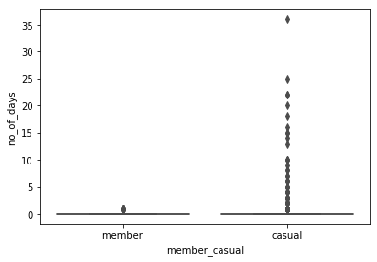
Bivariate Analysis: Categorical to Numerical

Slide 11
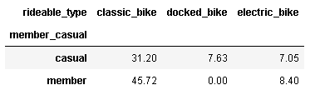
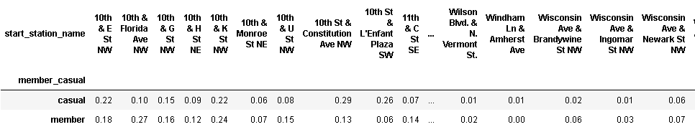
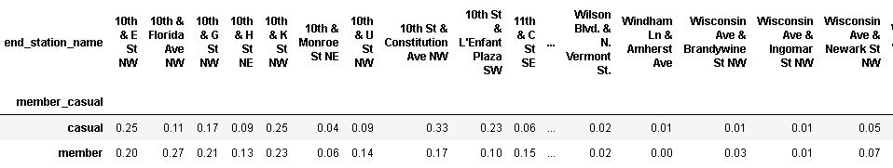
Bivariate Analysis : Categorical-Categorical

Slide 12
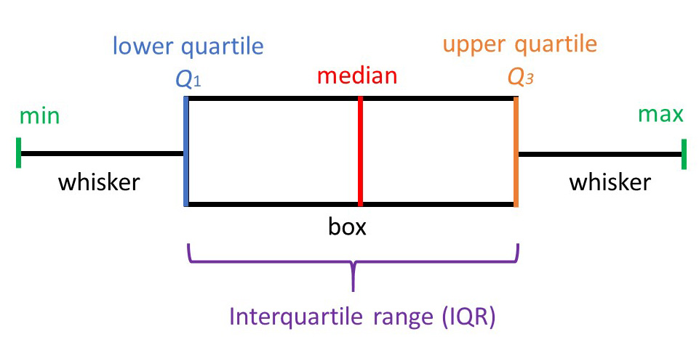
Outlier Treatment
Using IQR performed Outlier Treatment
Keeping Threshold to 2
IQR = q3 – q1

Slide 13
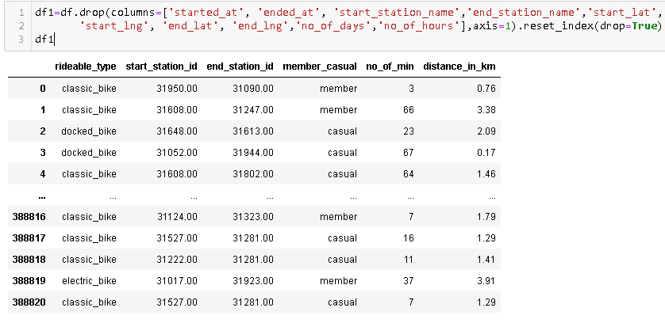
Dropping Few columns

Slide 14
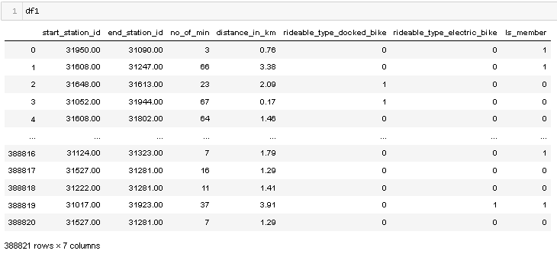
One Hot Encoding

Slide 15
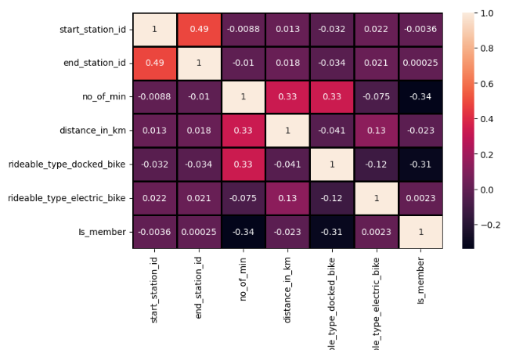
Heat Map to Check the Correlation

Slide 16
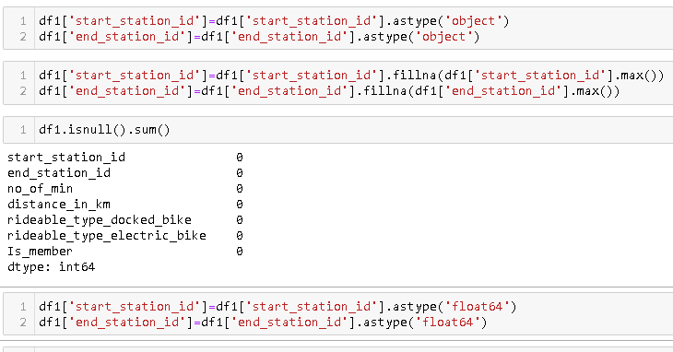
Filling the Null Values with Mode

Slide 17
Model Building
Since Problem is Classification Problem the models would be:
Logistic Regression Model
Random Forest Model
Gradient Booster Classifier model
Using Evaluation Matrices to find:
Accuracy
F1 Score

Slide 18
MODELS COMPARISION
Logistic Regression
Random
Forest
Gradient
Boosting
Training | Testing
64% | 64%
66% | 66%
63% | 63%
72% | 72%
Training | Testing
83% | 72%
85% | 73%
82% | 71%
86% | 76%
Training | Testing
69% | 69%
71% | 71%
68% | 68%
75% | 75%
Accuracy
Precision
True Positive Rate
Performance(F1)
Notes:
Note

Slide 19
Recommendation
Use of Random Forest is Better
Since it is Providing the Highest F1 Score( 86% & 76%) and Accuracy (83% and 72%)
Features that are Highly Influencing:
No_of_min(Duration )
Distance in KM(min Distance)
The Ratio of Members and Casual are not that much Different
The most Member tend to use Classic Bikes but don’t Preferer Docked Bikes

Slide 20
For More Info on Notebook and Working check here
https://github.com/vdj-vasudevan/capitalbikeshare/blob/main/Model%20with%20no%20VIF.ipynb
Thank you

